Slide 1
Test Driven Development
Test First Development in .NET

Slide 2
Test Organization
Strategies & Tips
Code coverage and the Sad Path

Slide 3
xUnit Architecture
Test Suite
Test Fixture
Test Case
Text Fixture
Test Case
Test Case
Test Case
Assertion
Assertion
Assertion
Assertion
Assertion

Slide 4
A Test Project
Test only the public API
Don’t tie tests to implementation details.
Think like a client
SUT Project
Test Project

Slide 5
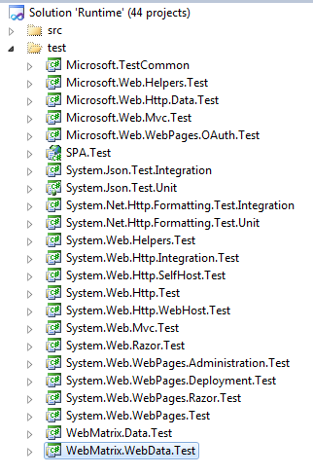
Test Project Organization
Test Project Per Solution?
Test Project Per Deployble Unit?
No Separate Test Project?
SUT Project
Test Project

Slide 6
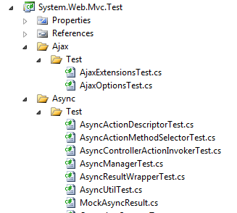
Test Organization
Fixture per class?
Fixture per behavior?

Slide 7
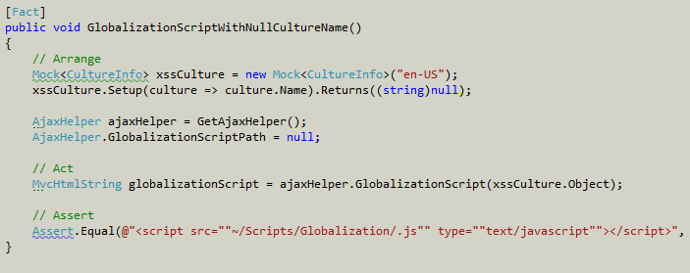
Test Method Organization
Arrange
Act
Assert
One logical assertion per test!

Slide 8
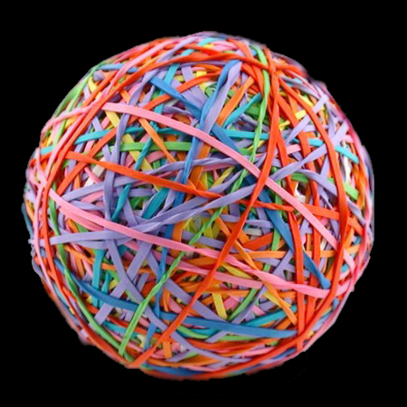
Test Code Is Important, Too!
Keep it maintainable and readable
Apply DRY (though maybe not to the same extreme)

Slide 9
Unit Tests versus Integration Tests
Object 1
Object 2
Object 3
Mathod A
Method B

Slide 10
Unit Testing Efforts
UI
MVC/MVP
Business / Domain
Data

Slide 11
Test Pyramid
GUI Tests
Acceptance Tests
Unit Tests

Slide 12
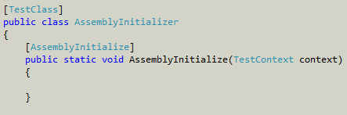
Test Lifecycle
Assembly Initialize
ClassInitialize
TestInitialize
TestCleanup
ClassCleanup
AssemblyCleanup

Slide 13
Happy Path
The optimal path of code execution given proper input
Sad Path
An undesired path of code execution Often caused by
How most developers think
Where we almost always start
Bad method inputs
Un-foreseen state

Slide 14
Why the Sad Path Matters
These things live in the sad path:
Bugs
Unknown behaviors
Resource leaks
Security vulnerabilities
We must assure good input
Think of this as “coding defensively”
For each method we create, consider “What would happen if someone … ?”
Remember GIGO?

Slide 15
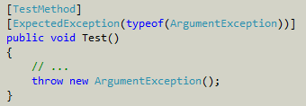
Exceptions
Exceptions won’t halt the test runner
Use ExpectedException to test for exceptional conditions

Slide 16
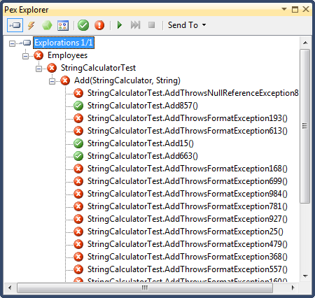
Pex
If you really want to catch the edge cases …

Slide 17
Principles
Write the tests first
Use the front door
Communicate the intent
Don’t modify the SUT
Isolate the SUT
Keep tests independent
Minimize test overlap
Minimize Untestable code
No test logic in production code
One logical assertion per test

Slide 18
Summary
Organization
Life cycle
Exceptions
Principles

